Slide 1
The Swiss Agency for Development and Cooperation (SDC)
Measuring Gender Equality for Development
South Caucasus Gender Equality Index (SCGEI)
ISET and ISET Policy Institute

Slide 2
ISET Policy Institute
The ISET Gender Equality Index for South Caucasus Countries
Modeled after the Gender Equality Index developed by the European Institute for Gender Equality (EIGE) for the European Union.
Utilizing indicators from public international databases, to maximize the comparability across countries.

Slide 3
ISET Policy Institute
What is in ISET Gender Equality Index
Core Domains
6
Work
Sub-Domains
11
Indicators
19
Money
Knowledge
Time
Power
Health
Countries
3+9
Tree South Caucasus countries: Georgia, Armenia and Azerbaijan.
Benchmark countries: Bulgaria, Czech Republic, Estonia, Hungary, Latvia, Lithuania, Poland, Romania and Slovenia.
Years
2020
ILO
UNDP
UNESCO Institute for Statistics (UIS)
World Bank (WDI and Gender Statistics)
WHO
Country Reports

Slide 4
ISET Policy Institute
Process
Selection and processing of indicators
Calculating gender gaps
Calculating the correcting coefficient
Calculating the gender gap metric
Calculating the Index

Slide 5
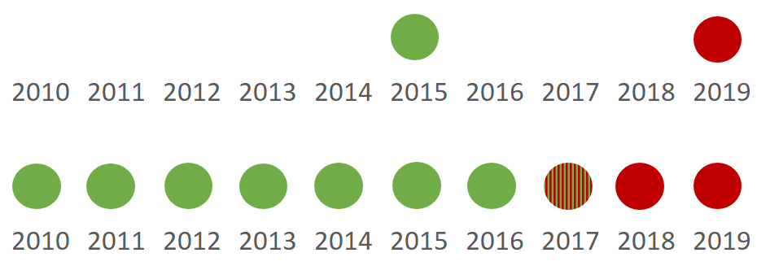
ISET Policy Institute
Methodology
Processing of variables:
Ensuring that variables measure gender equality in a homogenous way - the sign or the direction in the interpretation;
Imputation of missing data – closest value
Original
Imputed

Slide 6
ISET Policy Institute
Methodology
Calculating Gender Gap:
$γ_{{(x}_{it})}=|\frac{{\tilde{x}}_{it}^{w}}{{\tilde{x}}_{it}^{a}}−1|$,
Where the calculation is carried out for the variable X for the i-th country in the period t in order to obtain the percentage that women (${\tilde{x}}_{it}^{w}$) represents over the country average (${\tilde{x}}_{it}^{a}$);
It takes values between 0 and 1, where 0 stands for complete gender equality and 1 - full gender inequality.

Slide 7
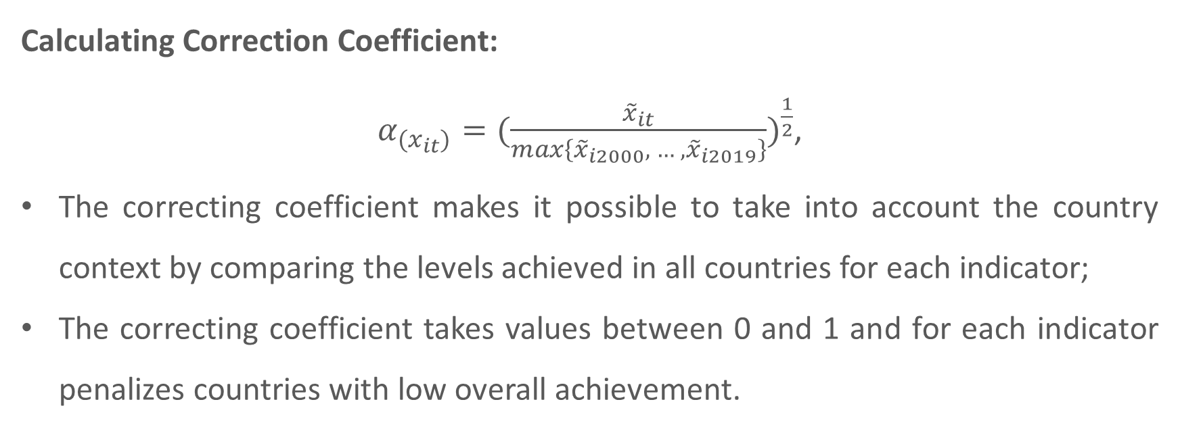
ISET Policy Institute
Methodology
Calculating Correction Coefficient:
${α_{{(x}_{it})}=(\frac{{\tilde{x}}_{it}}{max\left\{{\tilde{x}}_{i2000}, … , {\tilde{x}}_{i2019}\right\}})}^{\frac{1}{2}}$,
The correcting coefficient makes it possible to take into account the country context by comparing the levels achieved in all countries for each indicator;
The correcting coefficient takes values between 0 and 1 and for each indicator penalizes countries with low overall achievement.

Slide 8
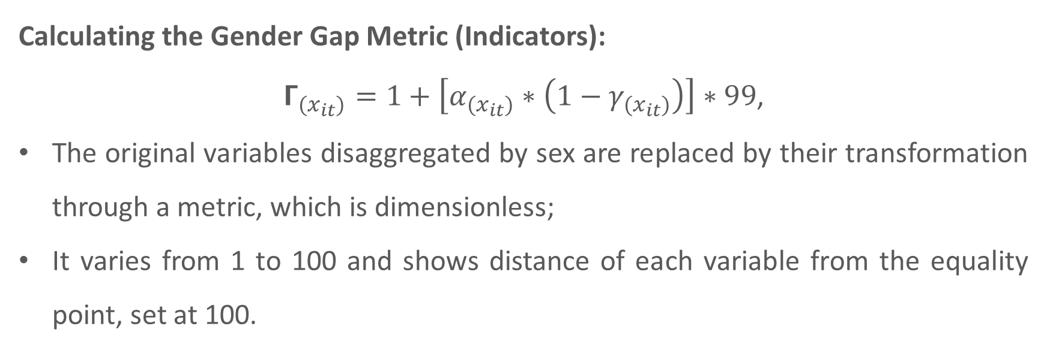
ISET Policy Institute
Methodology
Calculating the Gender Gap Metric (Indicators):
$Γ_{{(x}_{it})}=1+\left[α_{{(x}_{it})}∗\left({1−γ}_{{(x}_{it})}\right)\right]∗99$,
The original variables disaggregated by sex are replaced by their transformation through a metric, which is dimensionless;
It varies from 1 to 100 and shows distance of each variable from the equality point, set at 100.

Slide 9
ISET Policy Institute
Methodology
Characteristics of the Gender Equality Index
 | Indicators | Sub-domains | Domains
Aggregation | Arithmetic | Geometric | Geometric
Weighting | Equal | Equal | Experts
Imputation | Closest values | None | None
Mean experts’ weights used for the Gender Equality Index
Work | Money | Knowledge | Time | Power | Health
0.19 | 0.15 | 0.22 | 0.15 | 0.19 | 0.10

Slide 10
Domains, Sub-domains and Indicators
ISET Policy Institute

Slide 11
Work Domain
ISET Policy Institute
The domain of work measures the extent to which women and men can benefit from equal access to employment and good working conditions.

Slide 12
ISET Policy Institute
Work Domain [Sources: WDI]
Sub-domains:
Participation
Full-Time Equivalent employment (FTE) rate (%) [part time is considered as 0.5 and full time as 1].
Duration of working life (years, person aged 15+) [adjusted employment to population ratio (15+) * (expected life at birth)-15)].
Gender segregation and quality of work
Sectoral Segregation: Employed people in education, human health and social work activities (%, person aged 15+) [85 – education, 86 – human health activities, 87 – residential care activities, 88 – social work activities without accommodation]
Flexible Working Time Arrangements: Part-time Employment (% of total employment)
Job Prospects: 1 - Vulnerable employment (% of Estimated total employment)

Slide 13
Money Domain
ISET Policy Institute
The domain of money measures gender inequalities in access to financial resources and women’s and men’s economic situation.

Slide 14
ISET Policy Institute
Money Domain [Sources: UNDP, World Bank]
Sub-domain:
Financial resources
Gross National Income per capita (2017 PPP $) [GNI converted to international dollars (constant 2017) using purchasing power parity rates]
Financial Institution Accounts (% age 15+) [the share of women and men having checking accounts, saving accounts, money market accounts, time deposits (also known as Certificates of Deposit - CDs) and guardianship accounts]

Slide 15
Knowledge domain
ISET Policy Institute
The domain of knowledge measures gender inequalities in educational attainment and gender segregation.

Slide 16
ISET Policy Institute
Knowledge Domain [Sources: UIS, WDI]
Sub-domains:
Attainment and participation
Graduates of tertiary education [Educational attainment rate, completed short-cycle tertiary education or higher, population 25+ years].
Segregation
Percentage of graduates in fields of Science, Technology, Engineering and Mathematics (STEM) programmes (tertiary education).

Slide 17
Power domain
ISET Policy Institute
The domain of power measures gender equality in decision-making positions across the political and economic spheres.

Slide 18
ISET Policy Institute
Power Domain – EIGE [Sources: ILO, World Bank, National Sources, Eurostat]
Sub-domain:
Political
Share of ministers (%) [Proportion of female senior ministers (not including deputy ministers]
Share of members of parliament (%) [Proportion of seats held by women in national parliament (%)]
Economic
Proportion of women in managerial positions (%) [Employment in management is defined based on the International Standard Classification of Occupations]
Share of board members of central bank (%)

Slide 19
Time domain
ISET Policy Institute
The domain of time measures gender inequalities in allocation of time spent doing care and domestic work.

Slide 20
ISET Policy Institute
Time Domain [Sources: WDI, UNSTAT, country reports ]
Sub-domain:
Care activities
Proportion of time spent on unpaid domestic and care work (% of 24 hour day)
The definition of unpaid domestic and care work:
The average time women/men spend on household provision of services for own consumption. Domestic and care work includes food preparation, dishwashing, cleaning and upkeep of a dwelling, laundry, ironing, gardening, caring for pets, shopping, installation, servicing and repair of personal and household goods, childcare, and care of the sick, elderly or disabled household members, among others.

Slide 21
Health domain
ISET Policy Institute
The domain of health measures gender equality in three health -related aspects: health status, health behaviour and access to health services.

Slide 22
ISET Policy Institute
Health Domain [Sources: WHO, World Bank, Country Reports]
Sub-domain:
Status
Life expectancy at birth (years)
Healthy life years (HALE) at birth (years) [the number of remaining years that a person of a specific age is expected to live without any severe or moderate health problems]
Behaviour
People who don't smoke (%)
People who are not overweight (% of adults) [overweight is defined by WHO aby the following way: a BMI greater than or equal to 25]
Access
Probability of survival at age 5 [100 - mortality rate under-5]

Slide 23
ISET Policy Institute

